Slide 1
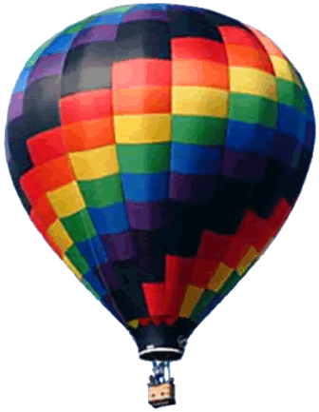
SOAR 2018: Galaxies
Aileen A. O’Donoghue Priest Associate Professor of Physics

Slide 2
Galaxies
9/4/18
  Milky Way Galaxy Contents & Motions
9/11/18
  Milky Way Environment & the Local Group
9/18/18
  Other Galaxies & Clusters of Galaxies
9/30/18
  Expansion, History & Evolution of the Universe

Slide 3
SOAR: Galaxies
The Milky Way Environment & the Local Group
Aileen A. O’Donoghue Priest Associate Professor of Physics

Slide 4
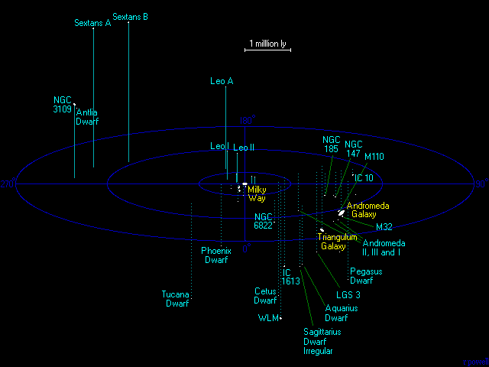

The Local Group
The Milky Way’s Galaxy Cluster
> 54 galaxies within 5 million light years
Triangulum (M110)
Milky Way
Andromeda (M31) & Satellites M32 & M33

Slide 5
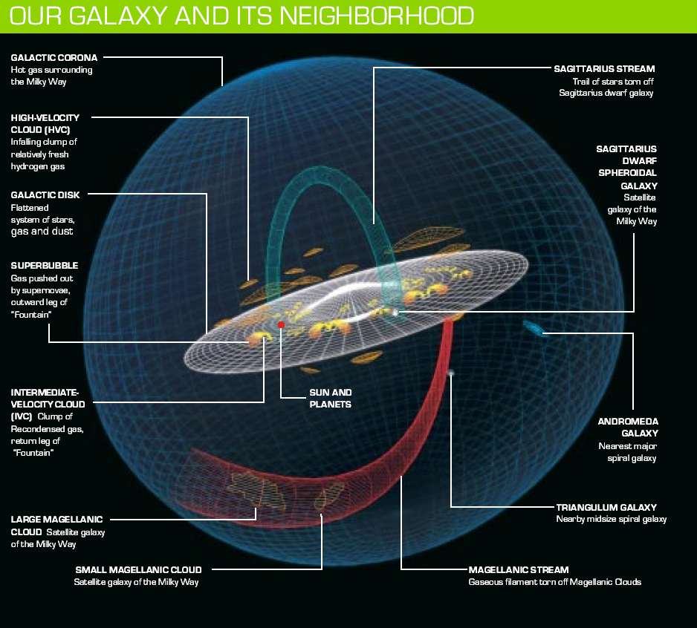
The ‘Hood

Slide 6
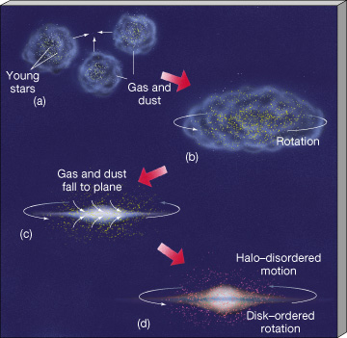
Milky Way’s Environment
IntraCluster Medium (ICM)
  Did galaxies form from this gas?

Slide 7
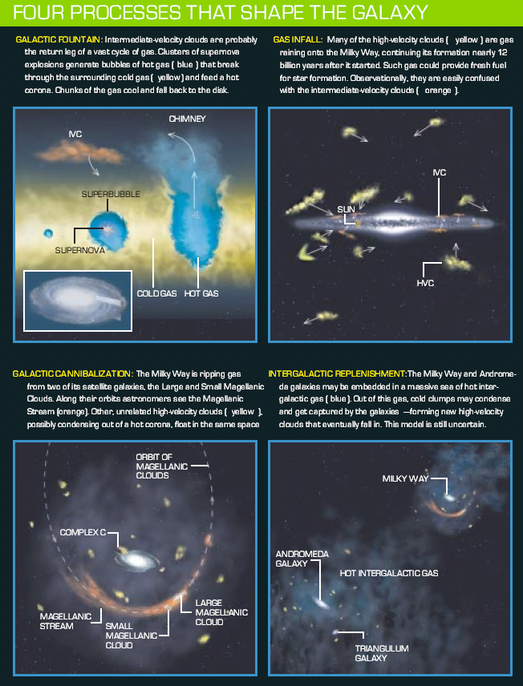
Milky Way’s Environment
Galaxies emit and absorb gas

Slide 8
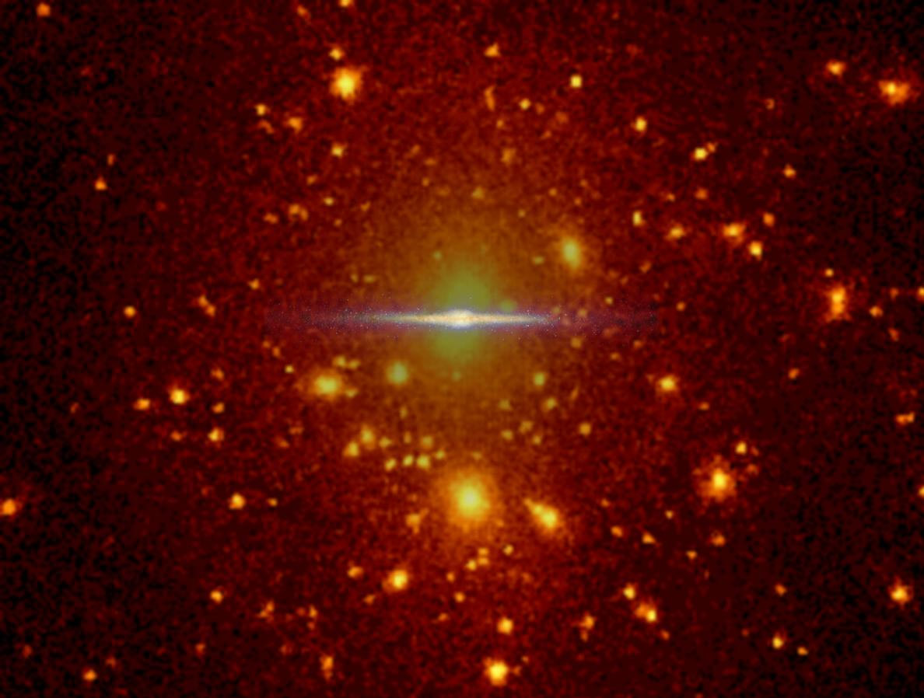

Milky Way’s Environment
Milky Way’s Lumpy Halo
  Stars, Globular Clusters, Gas, Dwarf Galaxies
Being studied by RAdial Velocity Experiment by Institutions from 11 nations

Slide 9
Galactic Cannibalism
Galaxies grow by eating their neighbors
MW has 9 dwarf companion galaxies
Halo stars from disrupted dwarfs

Slide 10
The Milky Way Growing?
Galaxies merge with other galaxies
  “Galactic Cannibalism”
Milky Way has two known merging galaxies
  Dwarf Elliptical Galaxy in Sagittarius
  Dwarf Galaxy in Canis Minor
    Closest galaxy in process of merging
Researchers expect to find more!

Slide 11
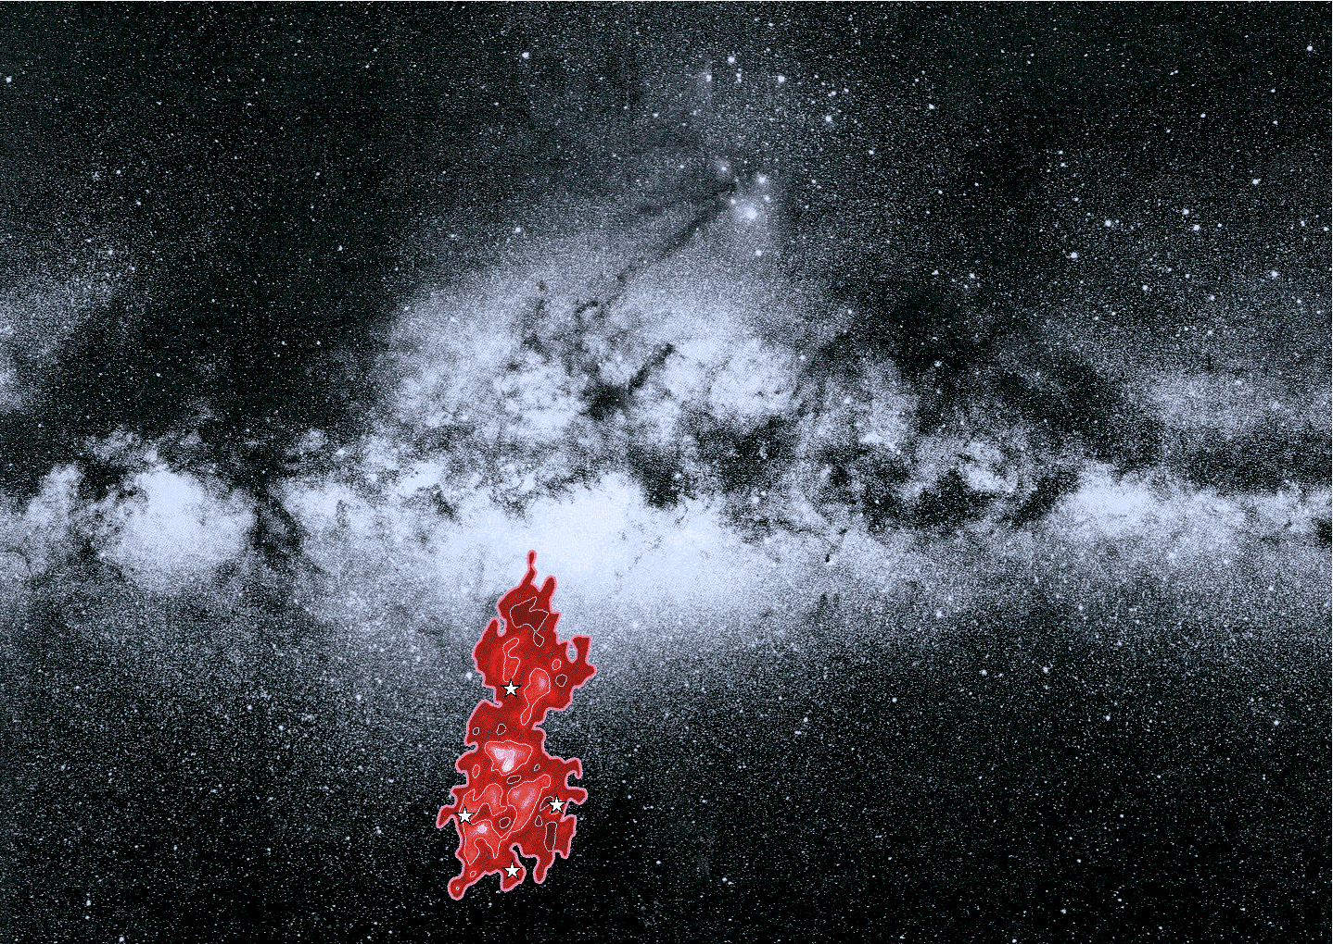
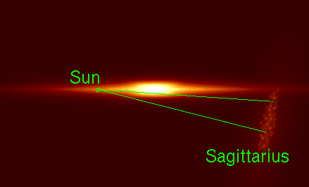
Sagittarius Dwarf Elliptical
Part of the “Sagittarius Stream” of gas & stars
  52 kly from galactic center
  Has passed through MW 10 times
    Dark Matter indicted by lack of disruption!
SgrDEG on far side of galactic center
Stars of SgrDEG have different speeds than MW stars

Slide 12
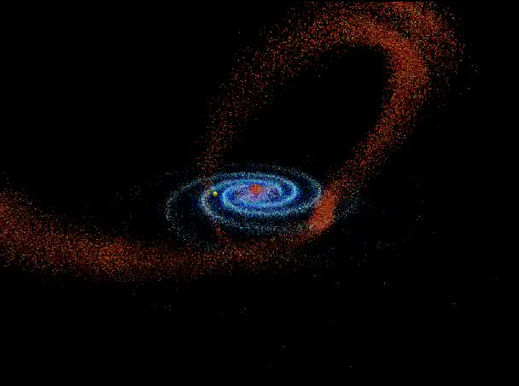
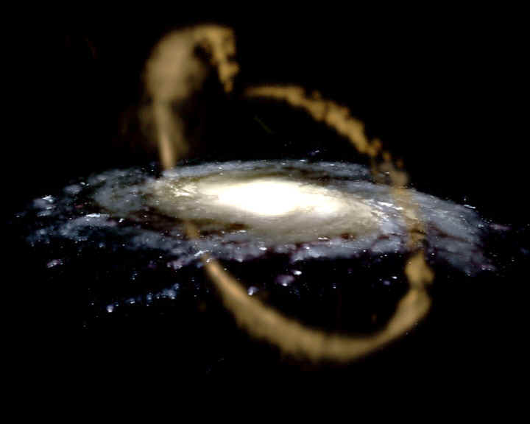
Sagittarius Stream
Stars & gas stripped from SgrDEG
APOD image of Sagittarius Stream
“Flyaround” of Milky Way with Sagittarius Stream

Slide 13
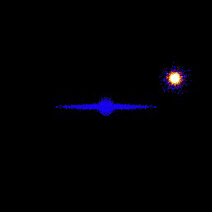
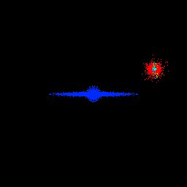
Sagittarius Stream
Simulations of tidal stripping of SgrDEG
~ 2 billion BCE to 500 million CE
Color indicates stellar density
Color indicates time of tidal stripping
Simulations by Kathryn V. Johnston, Wesleyan University

Slide 14
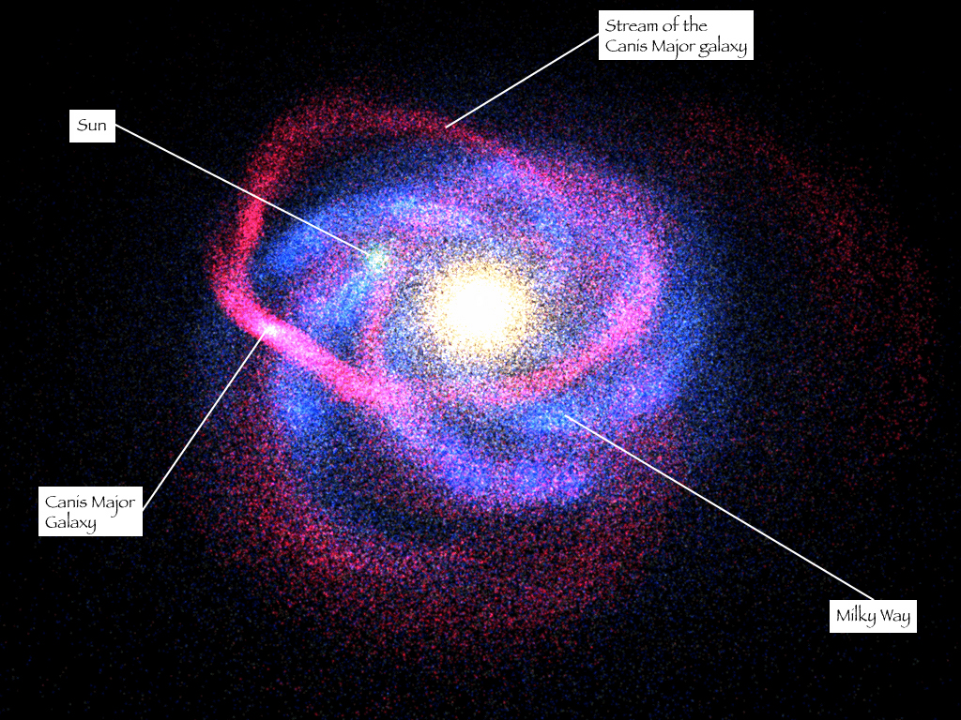
Canis Minor Dwarf
Discovered in 2003, 25 kly from MW center

Slide 15
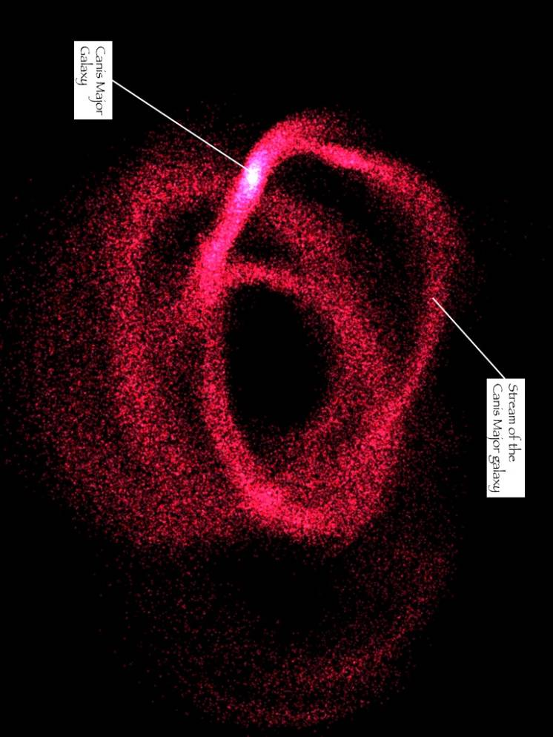
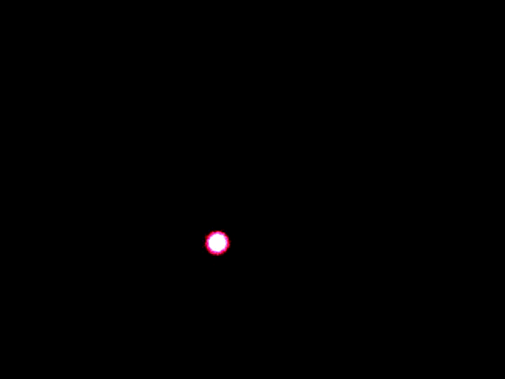
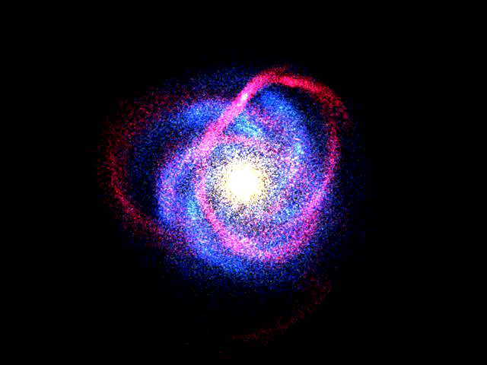
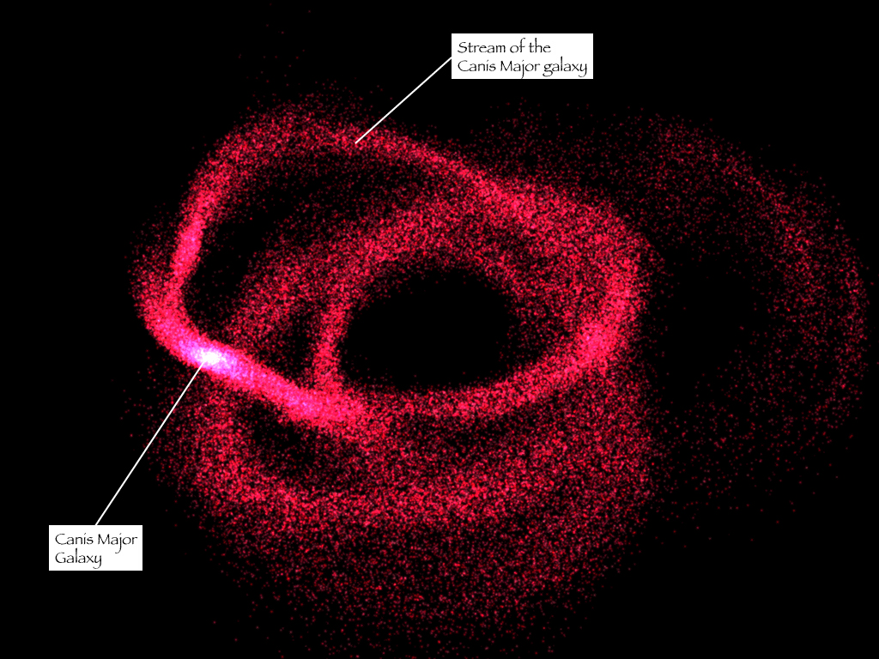
CMi Dwarf
Discovered in 2003
42 kly from MW center
Merging with MW

Slide 16
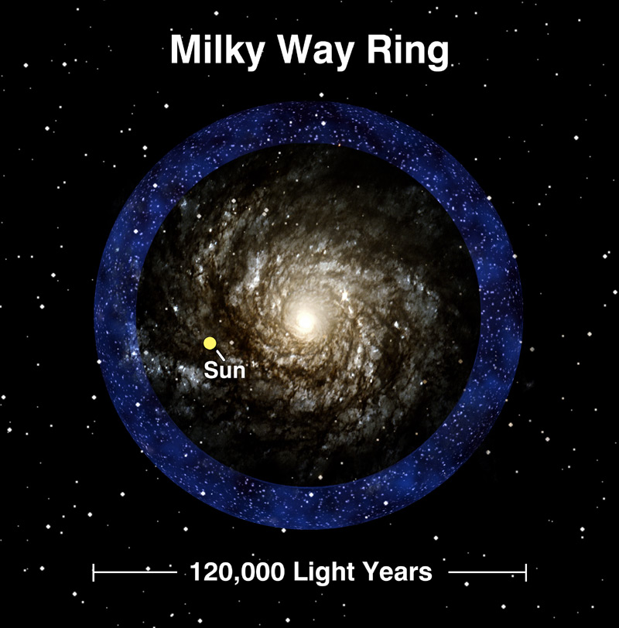
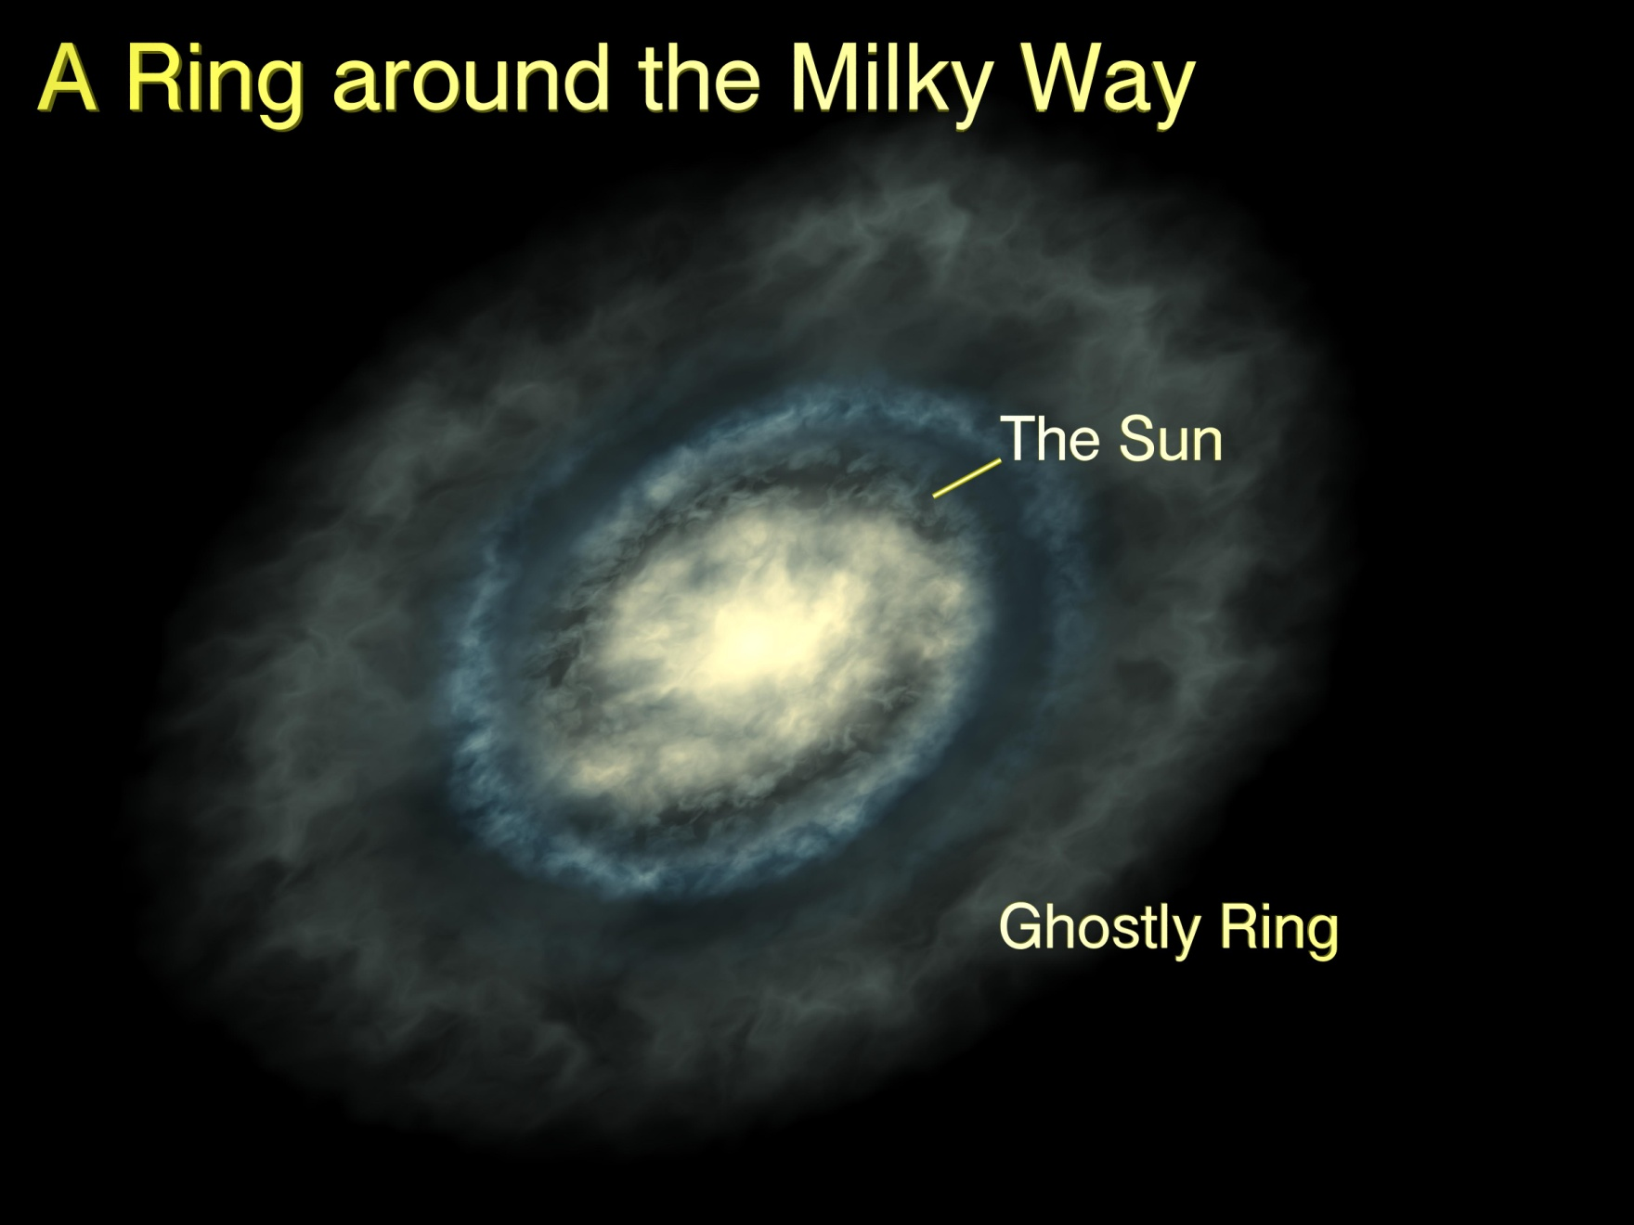
Milky Way Ring
Thick ring of stars beyond disk

Slide 17
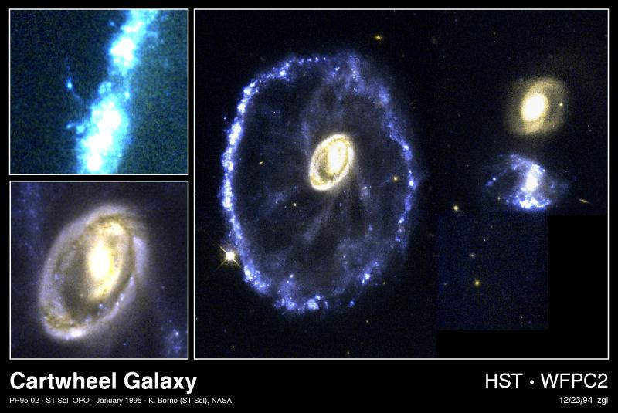
Milky Way Ring
Due to past galactic collision?
Star formation in ring of shocked gas
Which of these galaxies passed through one to left?

Slide 18
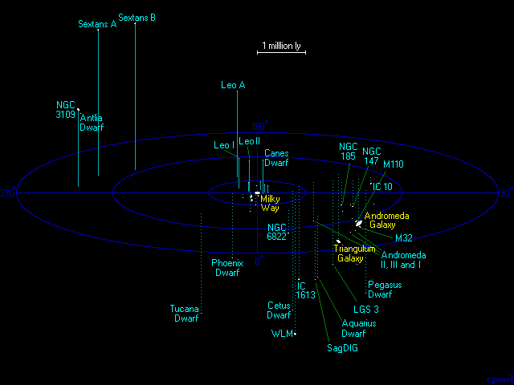
The Local Group
More than 54 galaxies
  Mostly dwarfs, including those merging with the Milky Way
3 Major spiral galaxies
  Milky Way, Andromeda & Triangulum
http://www.atlasoftheuniverse.com/

Slide 19
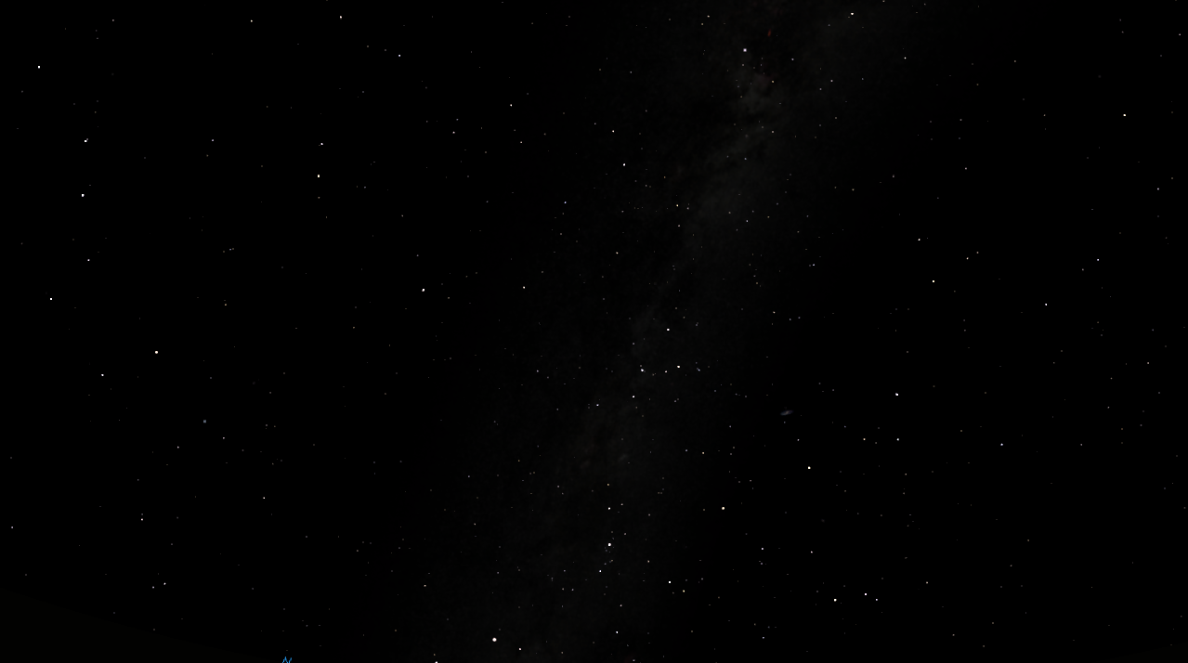
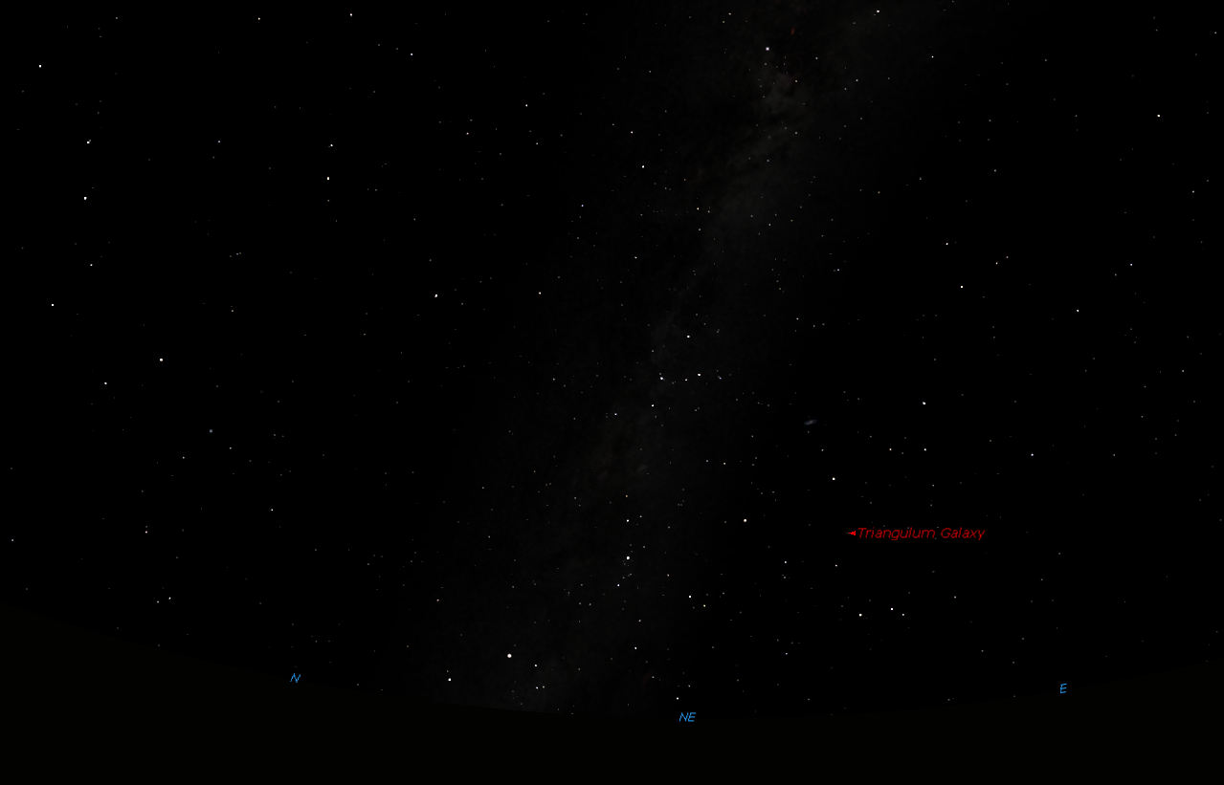
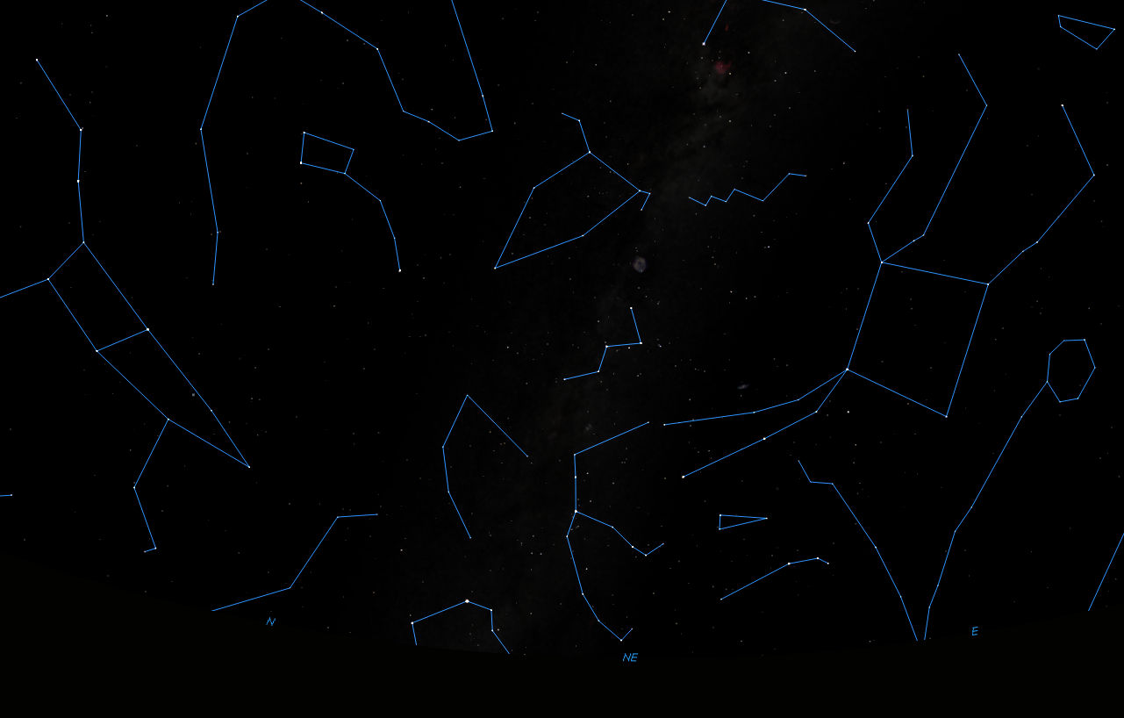
The Sky Tonight
Looking NE from Canton at 9:30 pm
Enif
Big Dipper
Little Dipper
Cepheus
Pegasus
δ Cephei
Polaris
Scheat
Great Square of Pegasus
Markab
Pointer stars point to …
Cassiopeia
Alpheratz
Andromeda Galaxy
Algenib
Andromeda
Perseus
Almach
Triangulum Galaxy
Rasalmothallah
Triangulum
Capella
Algol
Aries

Slide 20
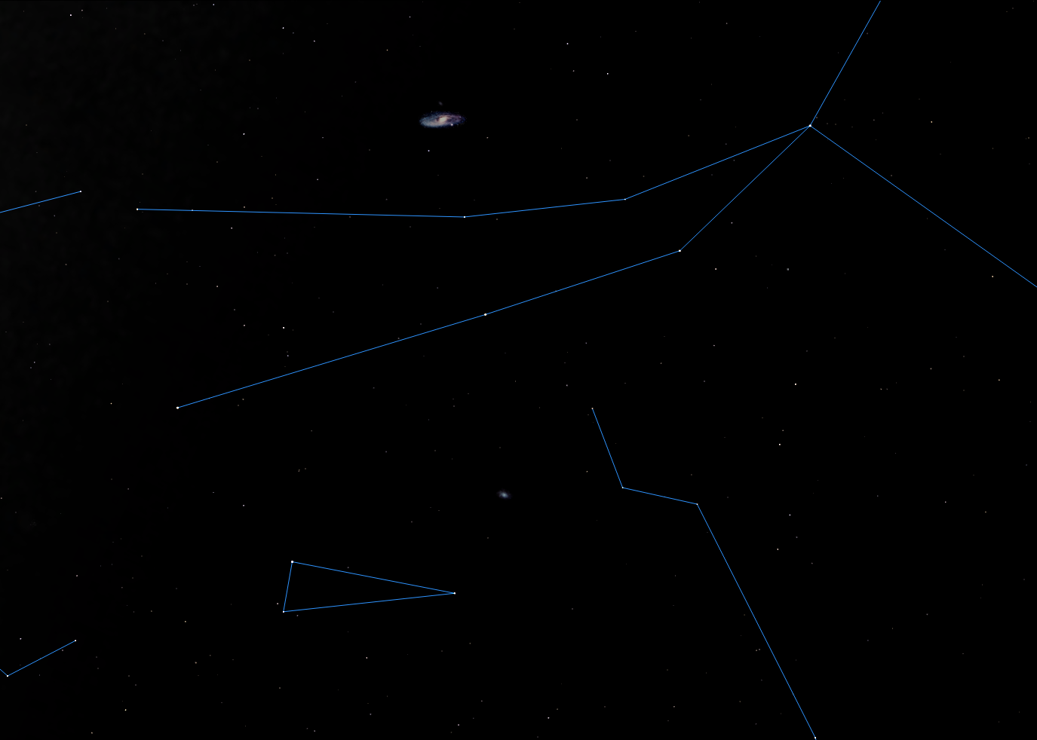
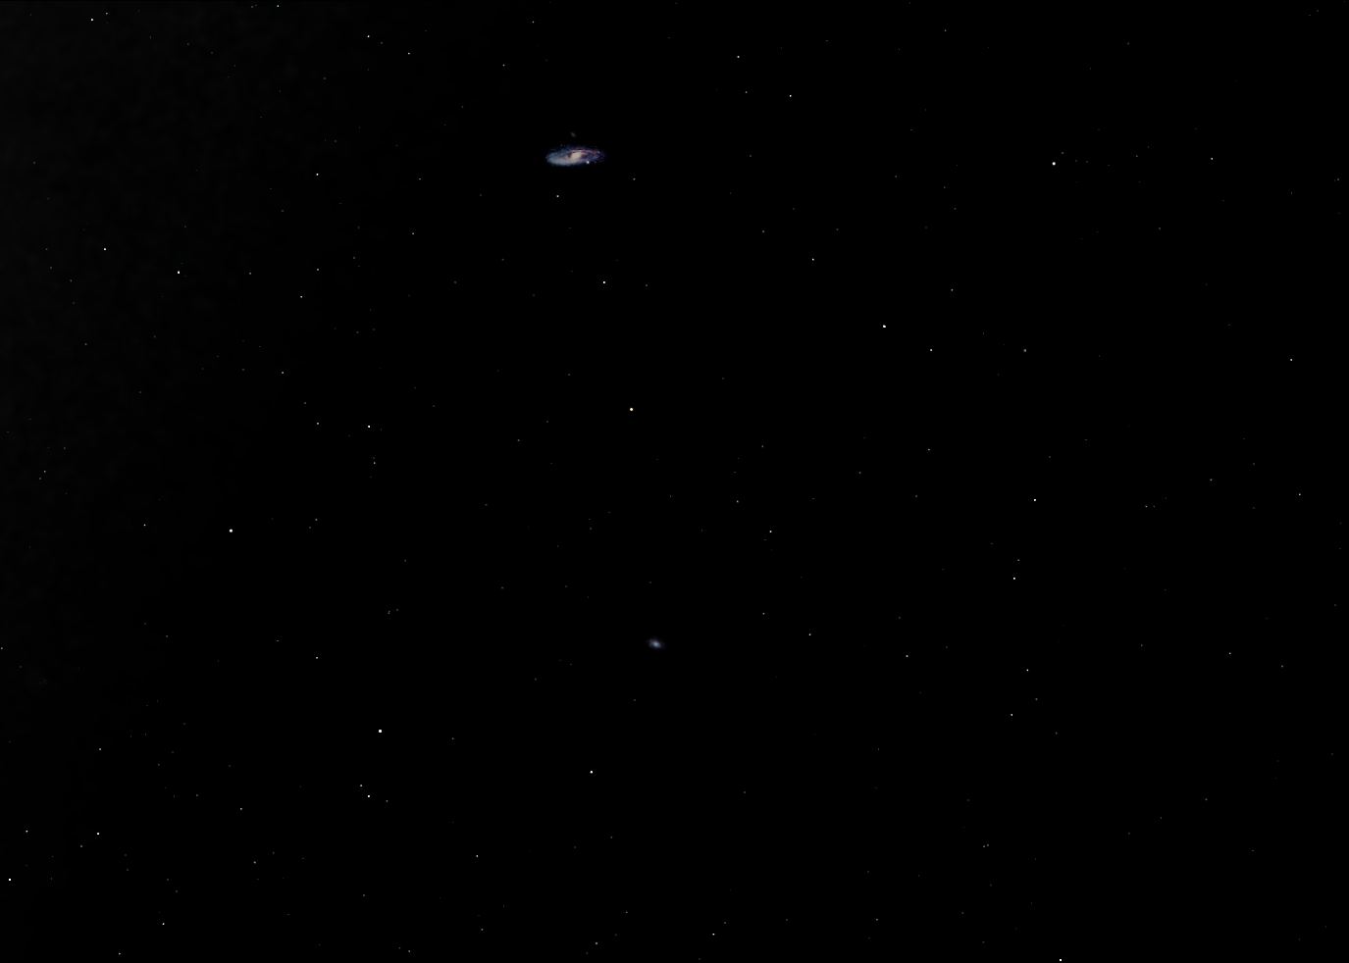
Finding Galaxies
Andromeda Galaxy
Alpheratz
Andromeda
Almach
Triangulum Galaxy
Rasalmothallah
Triangulum

Slide 21
Andromeda Galaxy
Local Group’s Largest Galaxy
  One Trillion Stars (10¹²)
  2.5 million light-years away
    1.5 x 10¹⁹ mi (1 ly = 5.88 x10¹² miles ~ 6 trillioin)
  200,000,000 M black hole in center
  Approaching us at 300 km/s (190 miles/sec)
    Should collide with Milky Way in ~4 billion years

Slide 22
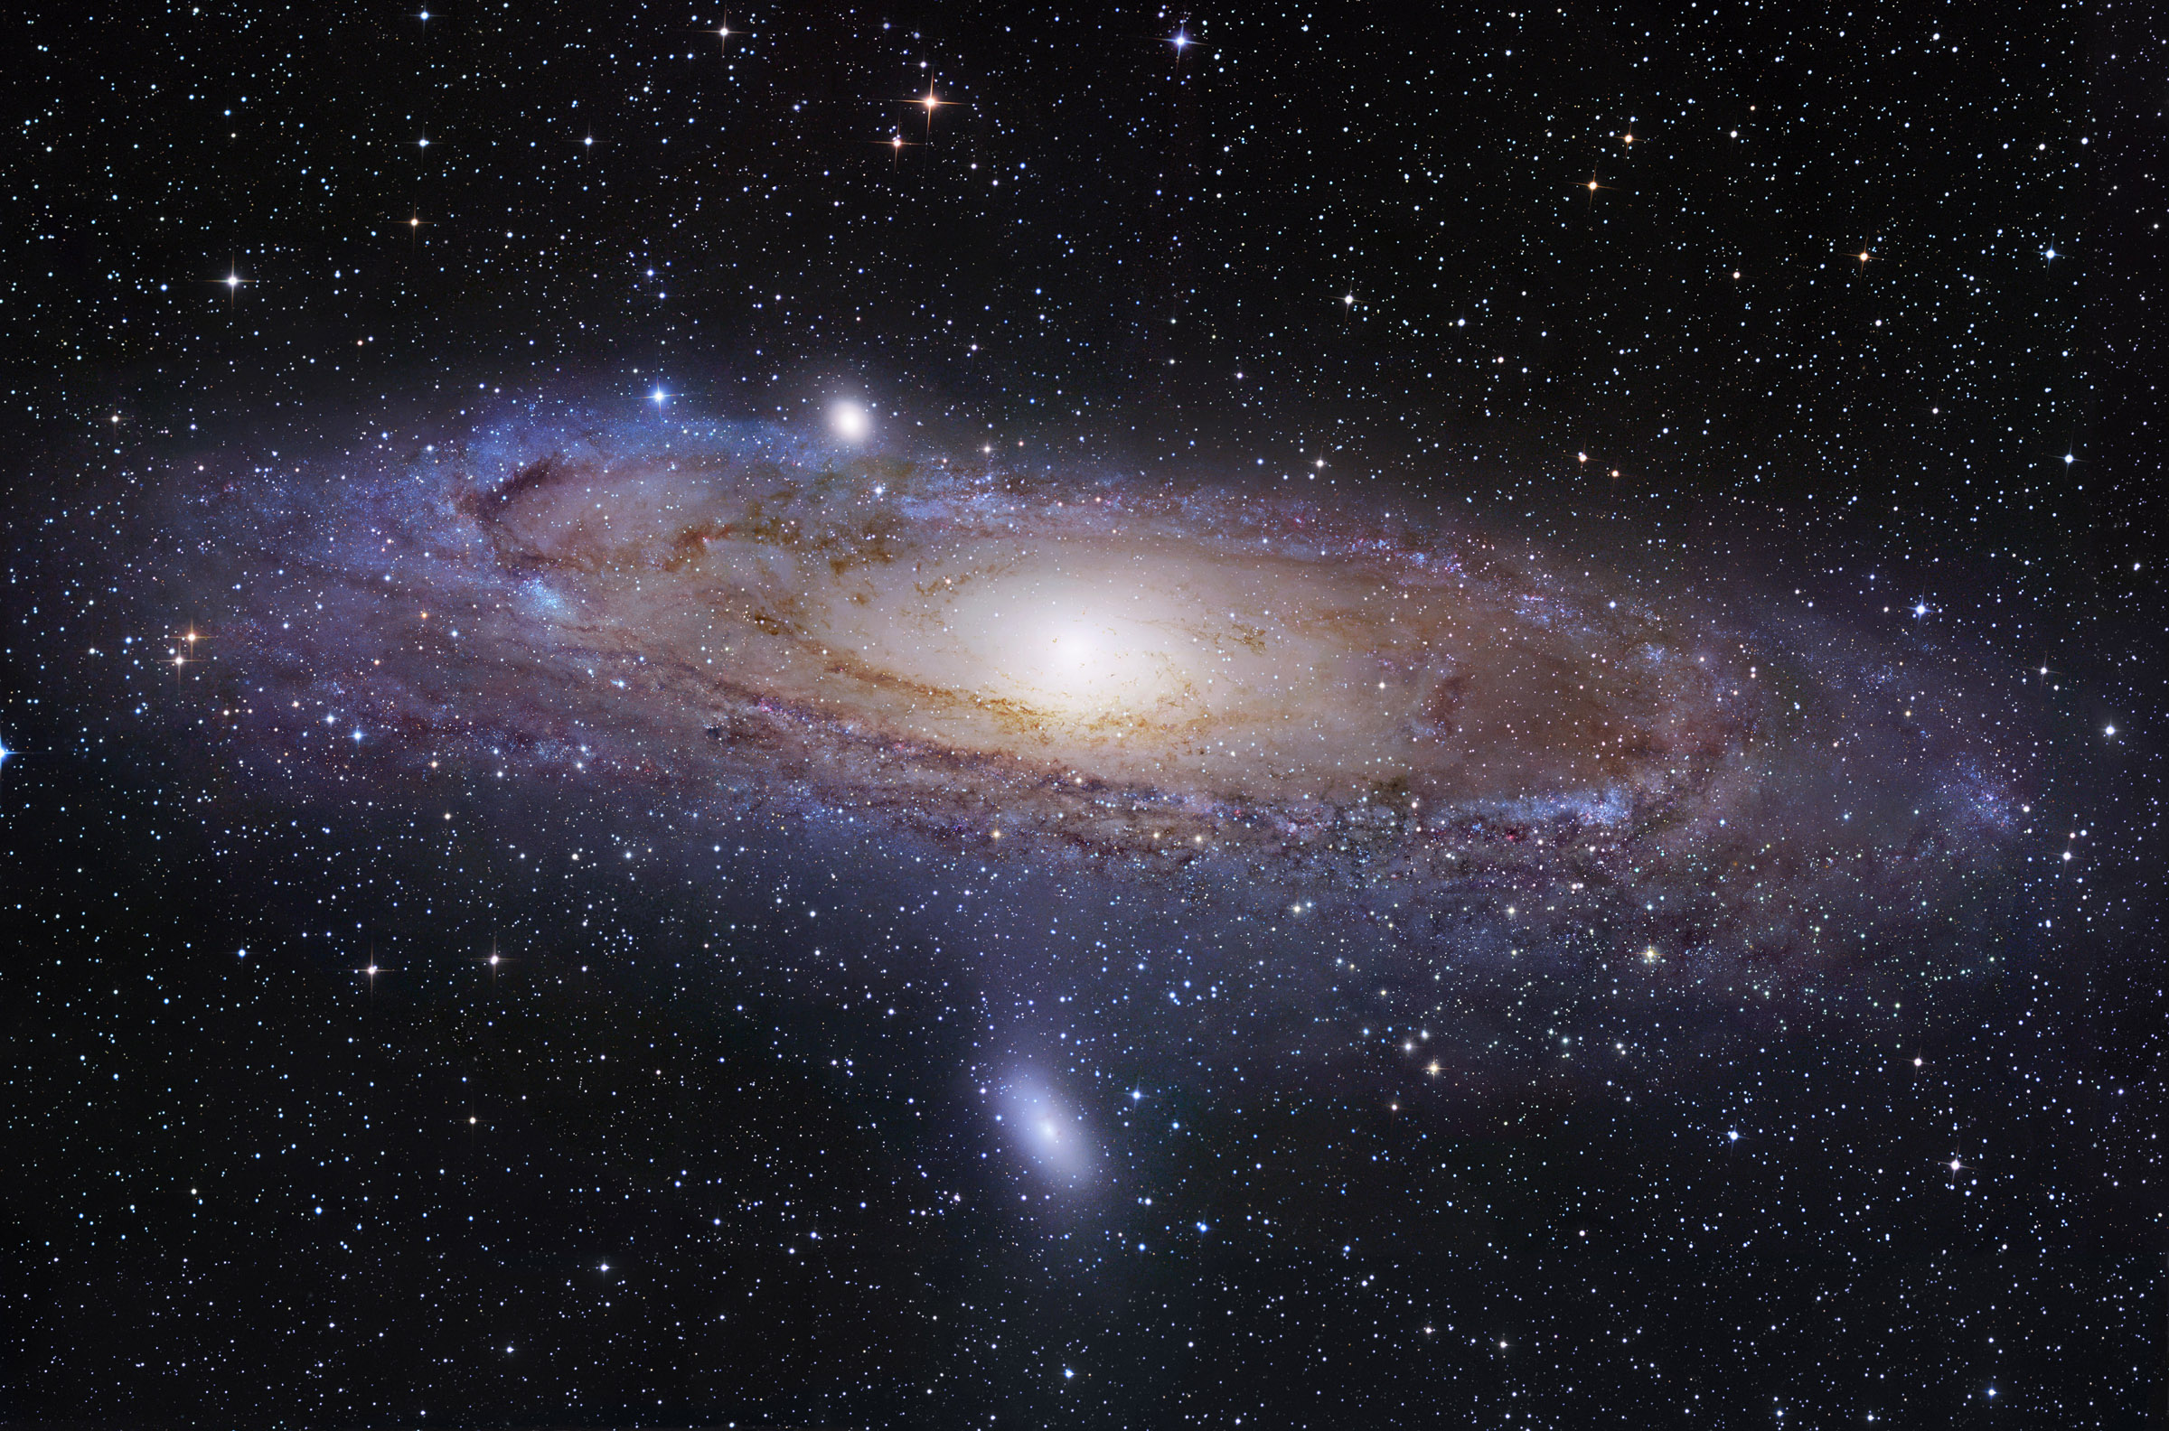
M32 – Dwarf Galaxy
M110 – Dwarf Galaxy

Slide 23
Triangulum Galaxy
Pinwheel Galaxy (M 101)
  40 Billion Stars (10¹⁰)
  3 million light-years away
    1.5 x 10¹⁹ mi (1 ly = 5.88 x10¹² miles ~ 6 trillioin)
  Linked to Andromeda by streams of stars and neutral hydrogen
  ⇒ interacted with Andromeda 2-8 by ago
  ⇒ will have more violent interaction in 2.5 my
  ⇒ may participate in collision with MW

Slide 24
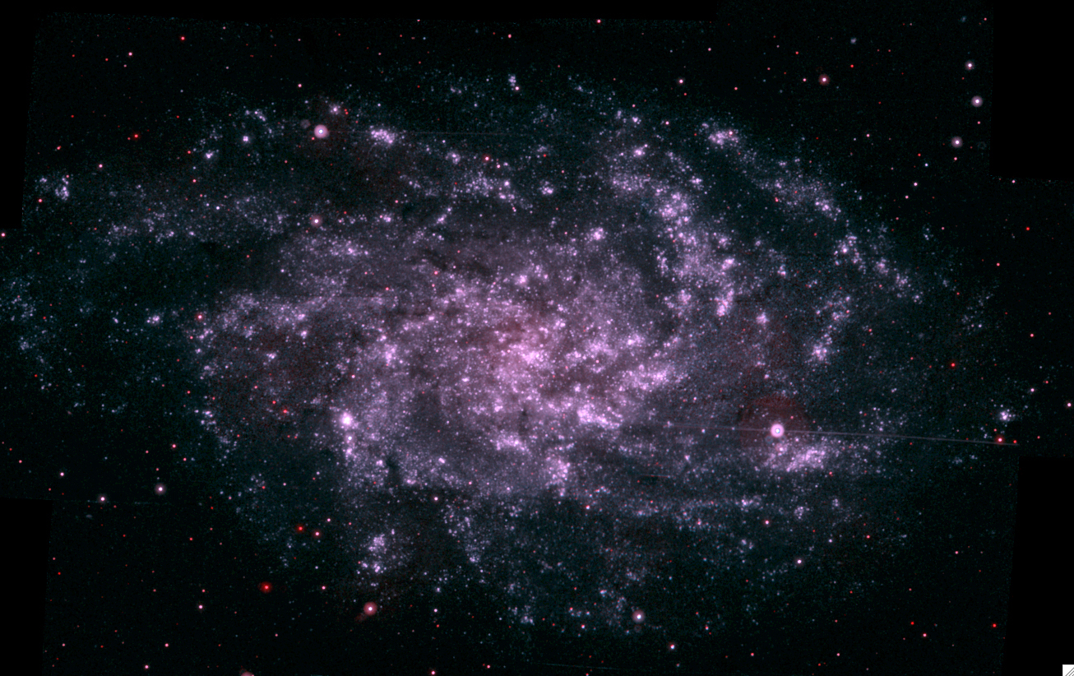
http://www.nasa.gov/topics/universe/features/molecule-fingerprints.html

Slide 25
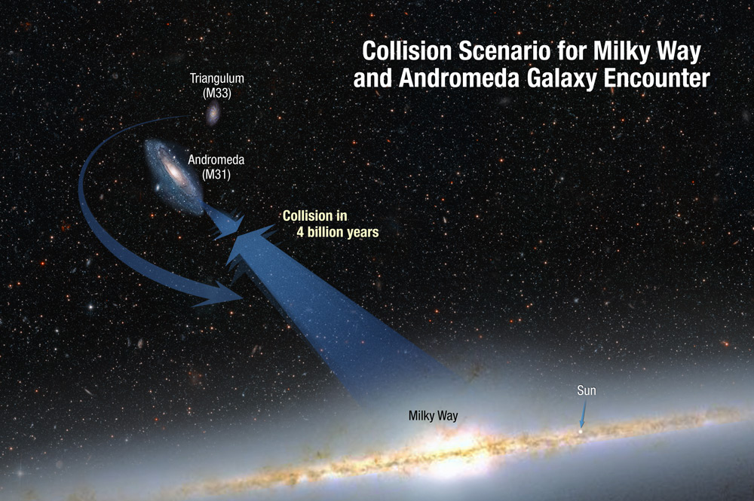
The Coming Collision
http://www.nasa.gov/mission_pages/hubble/science/milky-way-collide.html

Slide 26
Clusters of Galaxies
Gravitationally bound galaxy groups
  Require dark matter
    galaxies move too fast for glowing matter
    ⇒ map the distribution of dark matter!
Range in size and Richness
  Local Group = 54 members
  Virgo Cluster (nearest) = 1,300 – 2,000 mem.
  El Gordo (largest) = 1,000,000 members

Slide 27
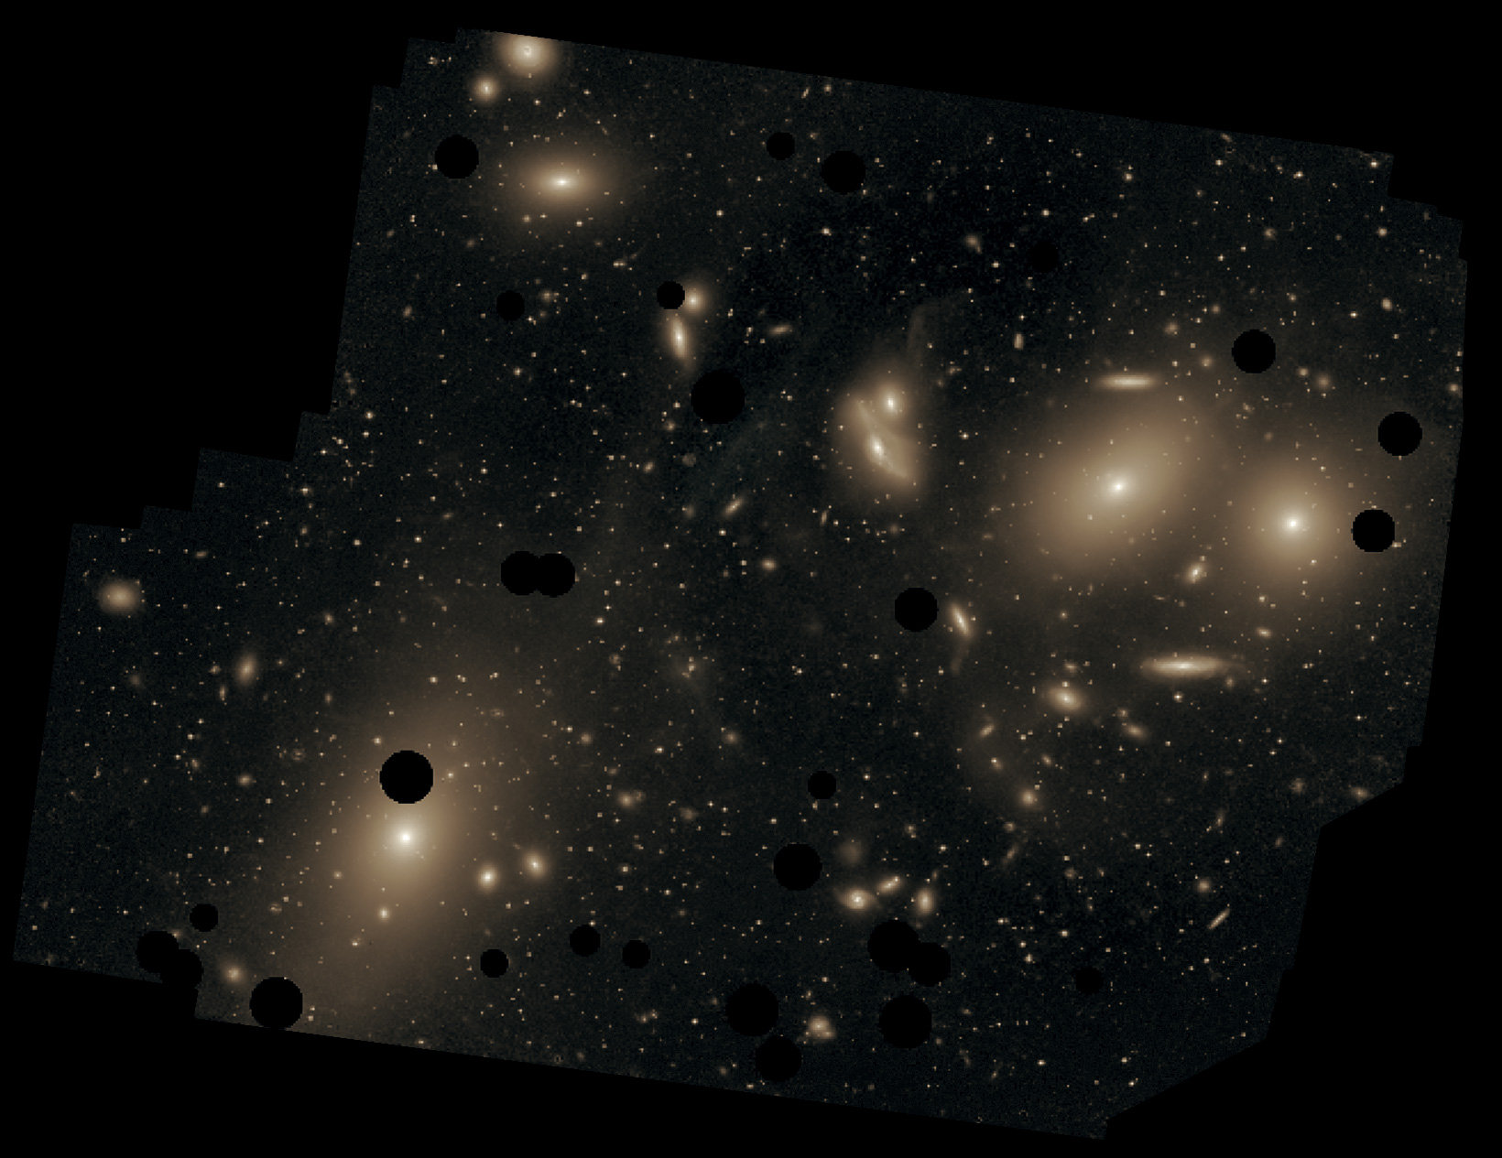
Clusters of Galaxies
Virgo Cluster of Galaxies seen from Kitt Peak, Arizona
Gravitationally bound galaxy groups
  Require dark matter
    galaxies move too fast for glowing matter
    ⇒ map the distribution of dark matter!
Range in size and Richness
  Local Group = 54 members
  Virgo Cluster (nearest) = 1,300 – 2,000 mem.
  El Gordo (largest) = 1,000,000 members
https://commons.wikimedia.org/wiki/File:ESO-M87.jpg

Slide 28
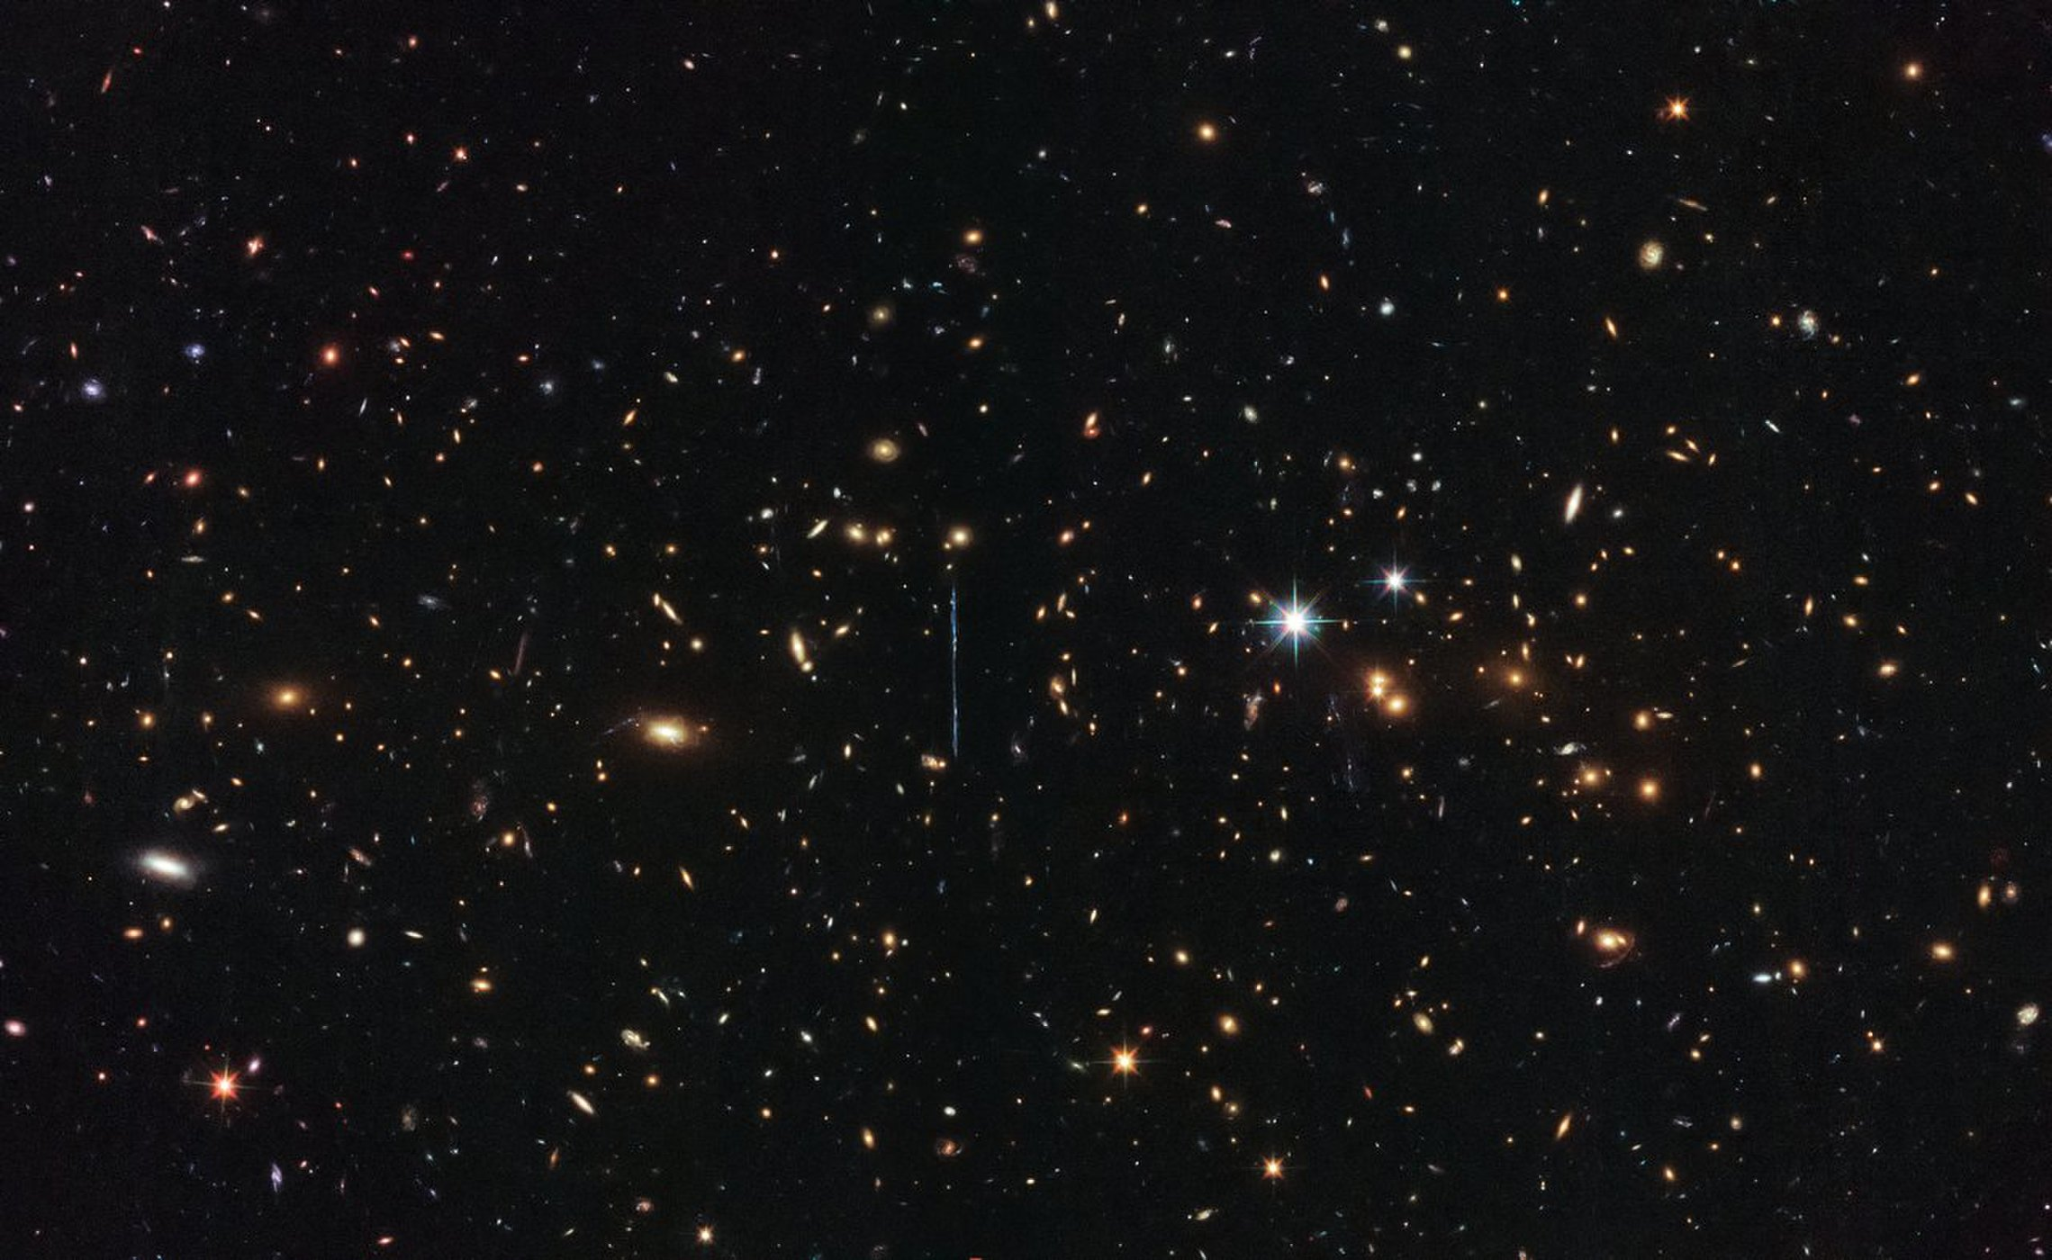
Clusters of Galaxies
El Gordo Cluster of Galaxies image from Hubble Space Telescope
Gravitationally bound galaxy groups
  Require dark matter
    galaxies move too fast for glowing matter
    ⇒ map the distribution of dark matter!
Range in size and Richness
  Local Group = 54 members
  Virgo Cluster (nearest) = 1,300 – 2,000 mem.
  El Gordo (largest) = 1,000,000 members
https://www.space.com/39424-el-gordo-galaxy-cluster-hubble-image.html

Slide 29
Clusters of Galaxies
Galaxies emit gas, dust, cosmic rays
  stellar explosions, collisions, etc.
Galaxy clusters have atmospheres
  Intracluster Medium (ICM)
    Glows in X-Rays due to electrons zipping by protons
X-ray emission
Thermal Bremsstrahlung Radiation

Slide 30
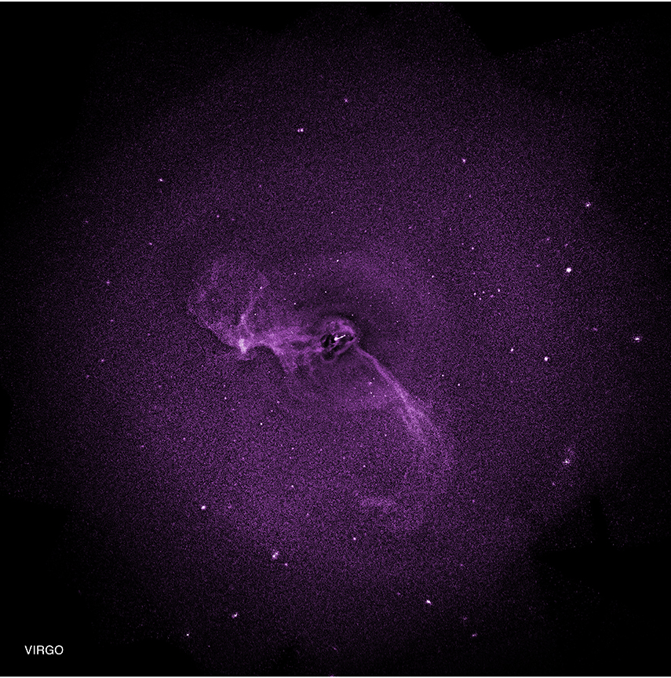
Clusters of Galaxies
Chandra X-Ray Image of Virgo
Galaxies emit gas, dust, cosmic rays
  stellar explosions, collisions, etc.
Galaxy clusters have atmospheres
  Intracluster Medium (ICM)
    Glows in X-Rays due to electrons zipping by protons
X-ray emission
Thermal Bremsstrahlung Radiation
http://chandra.harvard.edu/photo/2014/perseusvirgo/

Slide 31
Clusters of Galaxies
Galaxies emit gas, dust, cosmic rays
  stellar explosions, collisions, etc.
Galaxy clusters have atmospheres
  Glows in Radio due to electrons zipping along magnetic field lines.
f_{radiation}
∝
E_{electron}
Synchrotron Radiation

Slide 32
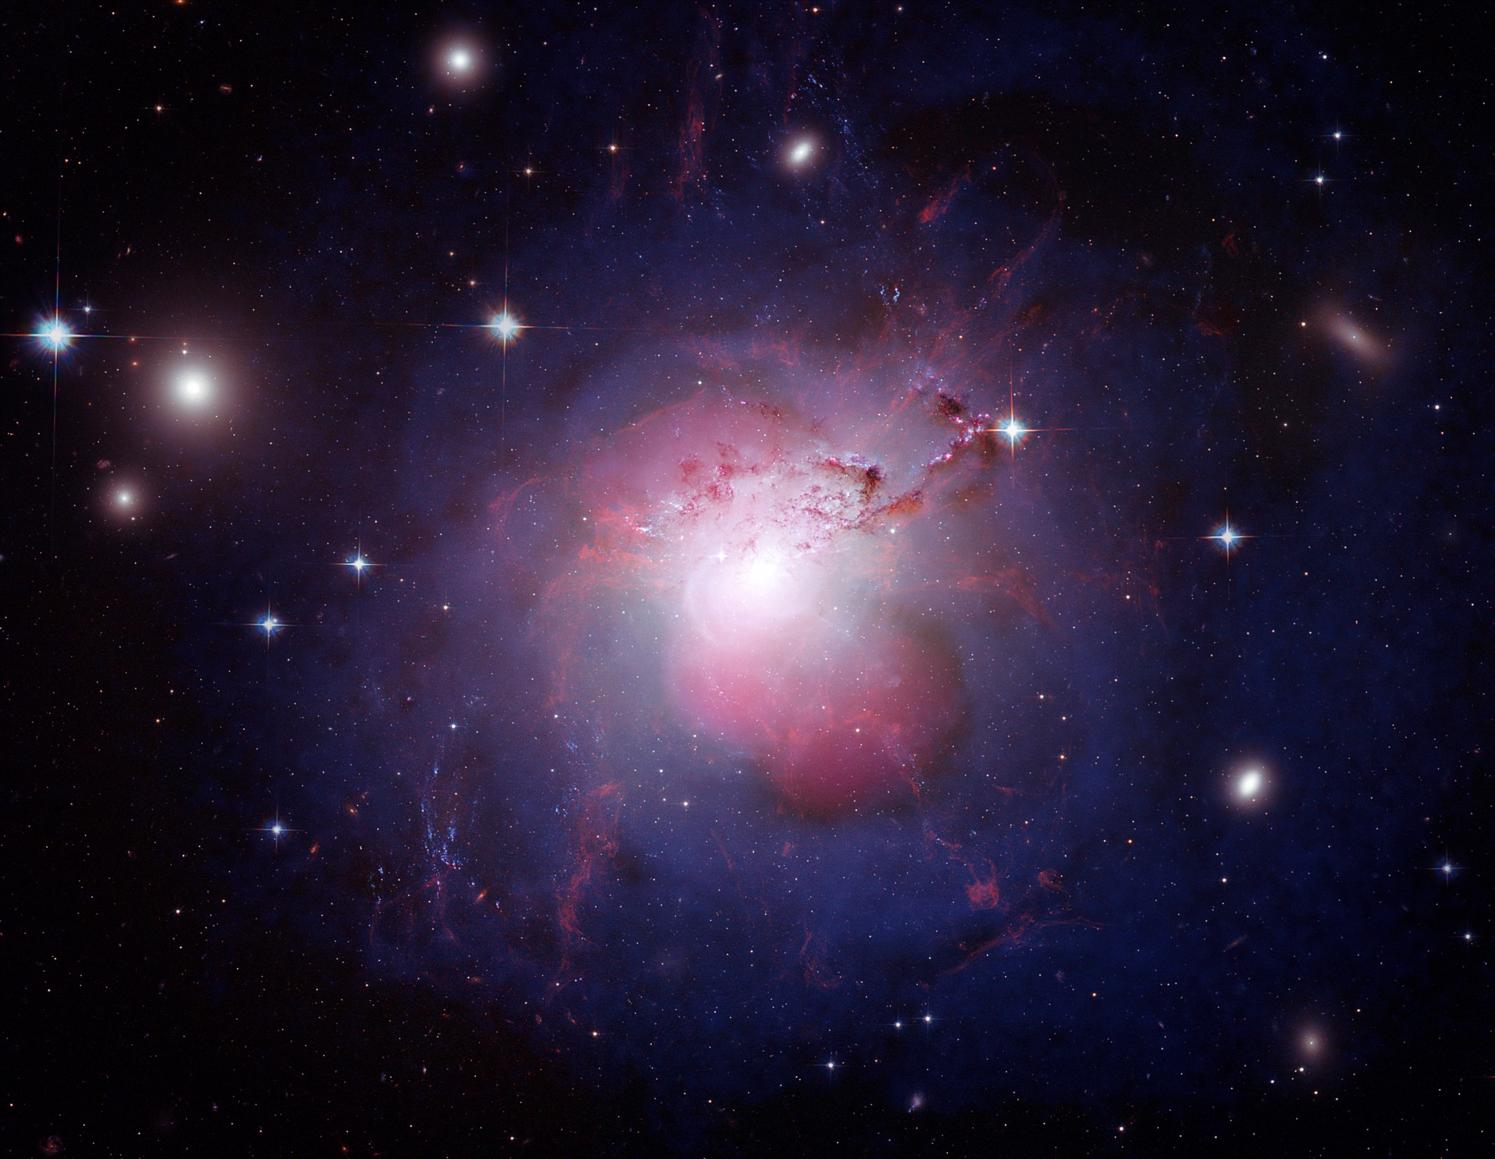
Clusters of Galaxies
Perseus A in the Perseus Cluster of Galaxies
Galaxies emit gas, dust, cosmic rays
  stellar explosions, collisions, etc.
Galaxy clusters have atmospheres
  Glows in Radio due to electrons zipping along magnetic field lines.
f_{radiation}
∝
E_{electron}
Synchrotron Radiation
Visible Hubble images with
Violet shells of X-ray gas
Pink jets and lobes of radio-luminous plasma

Slide 33



Seeing Dark Galaxies: The ALFALFA Survey
Aileen O’Donoghue
Priest Associate Professor of Physics
St. Lawrence University, Canton, NY

Slide 34

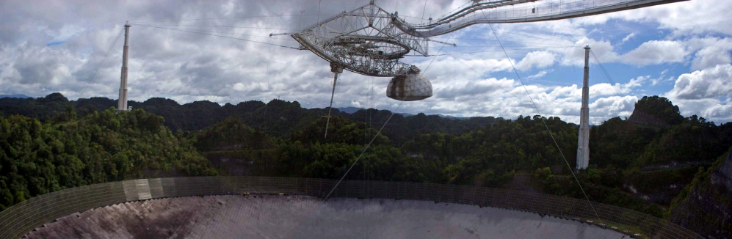
ALFALFA
Arecibo Fast ALFA Survey
  Arecibo
  ALFA
  L-Band
  Radio Galaxies
    Continuum Sources
    Spectral Line Sources
  ALFALFA Observations
  Some ALFALFA Results

Slide 35
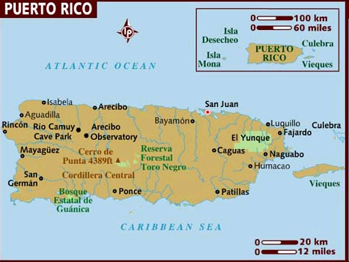
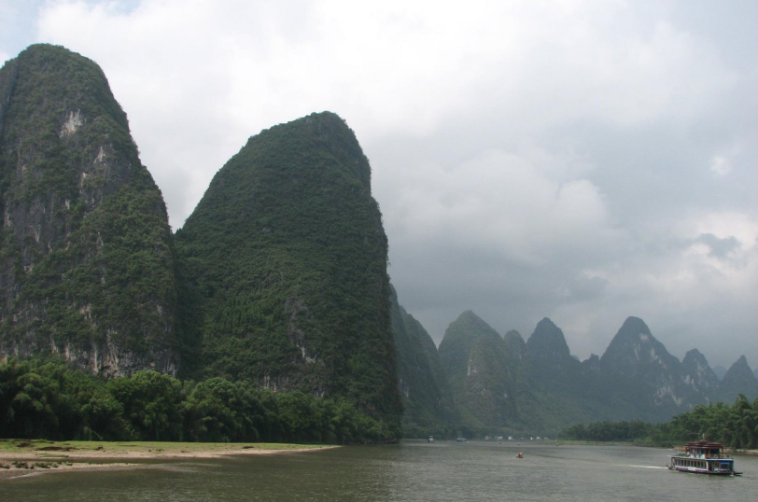
Arecibo Observatory
National Astronomy & Ionosphere Center
    Funded by NSF, administered by Cornell University
Arecibo, Puerto Rico
  Karst Topography
    Subsurface limestone ⇒ sink holes
    Like Gulin, China
Li River near Gulin, China

Slide 36
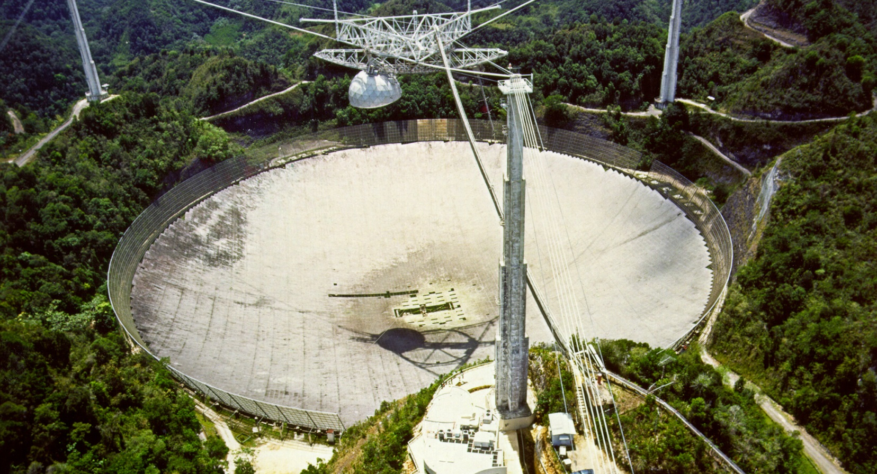
Arecibo Observatory
Largest Single-dish radio telescope
  diameter = 305 m = 1000 ft
  depth = 167 ft (870 ft sphere)
  40,000 3 x 5 aluminum panels

Slide 37
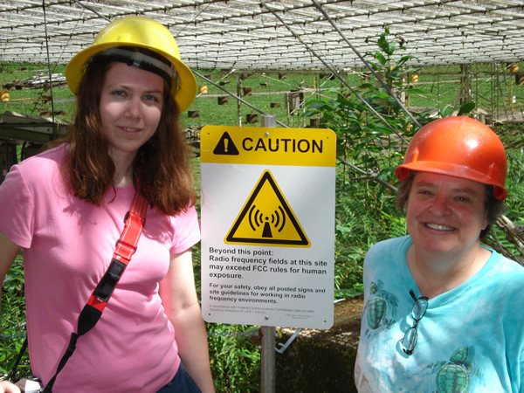
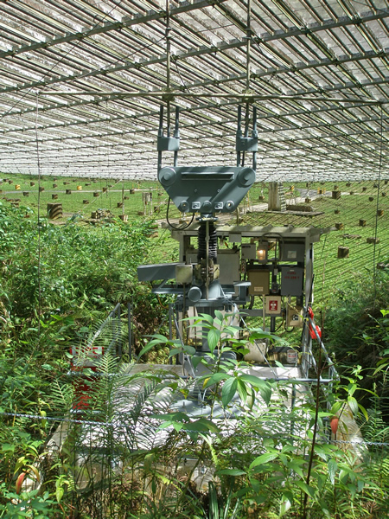
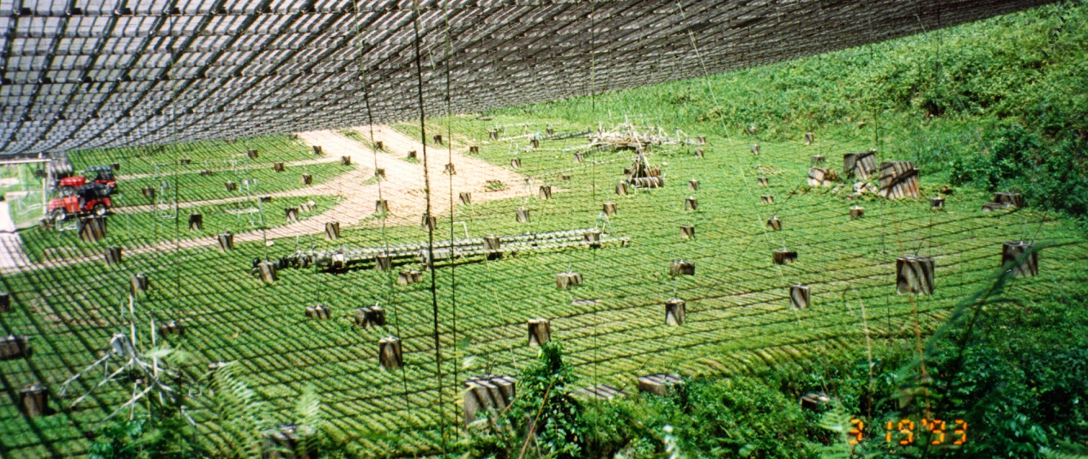
Arecibo Observatory
Largest Single-dish radio telescope
Tie-downs keep platform steady
Cables shape spherical dish

Slide 38
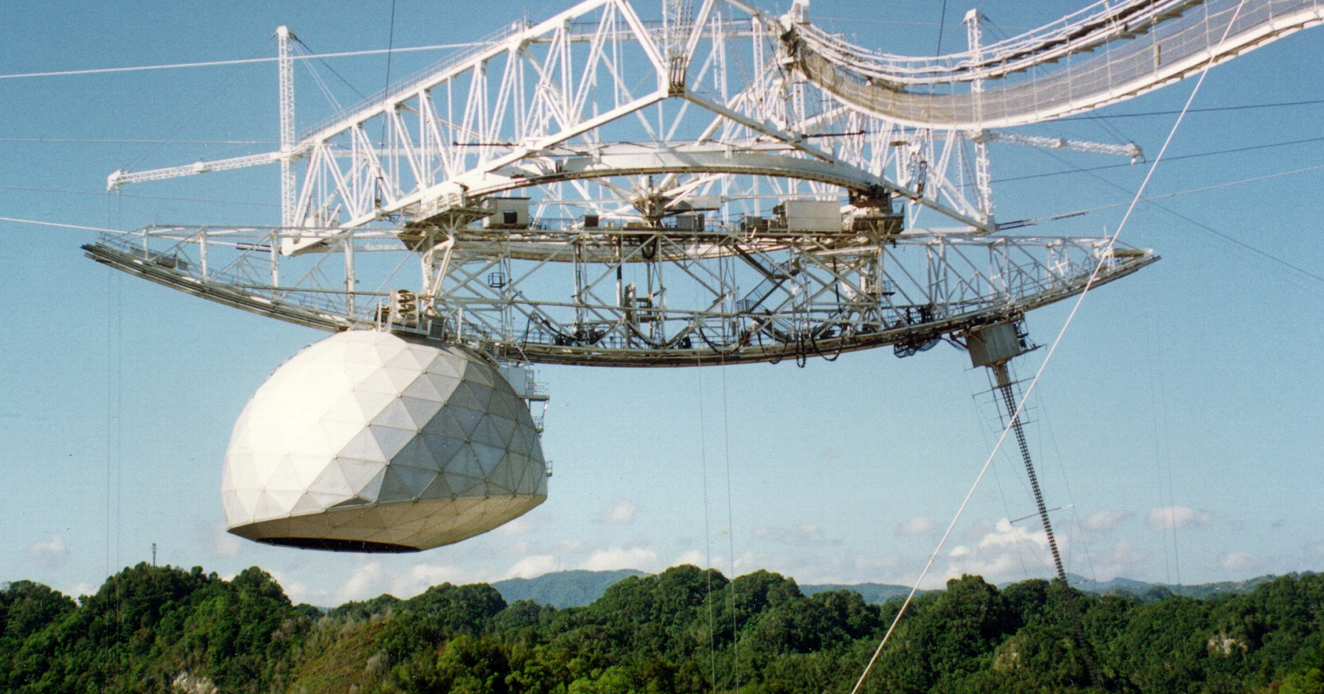
Arecibo Observatory
Instrument Platform
  weight = 900 tons, 18 supporting cables
  height = 450 ft above dish
  azimuth arm length = 328 ft
Gregorian Dome
430 MHz line feed

Slide 39
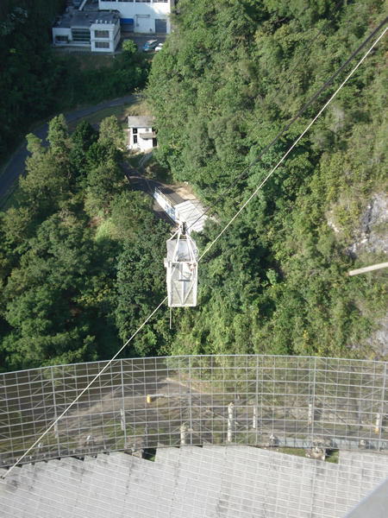
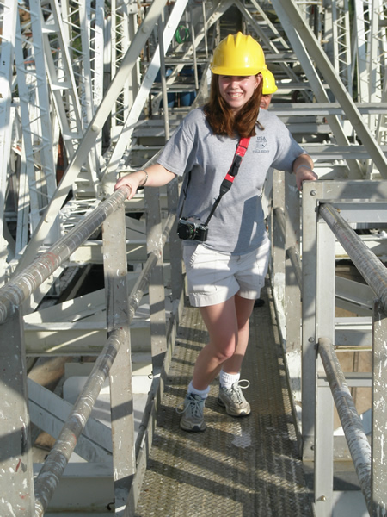
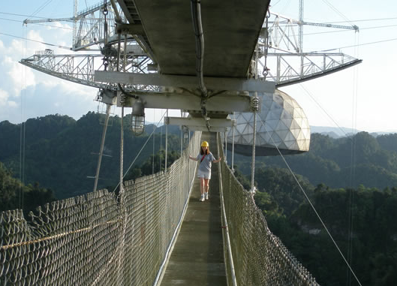
On The Platform
Up via cable car
Jamie on the azimuth arm
Down via catwalk

Slide 40
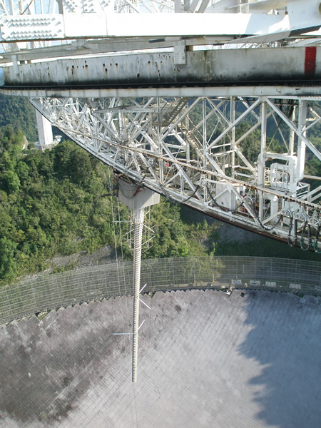
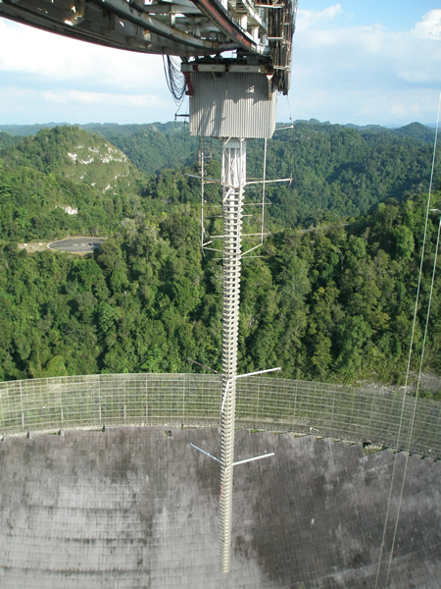
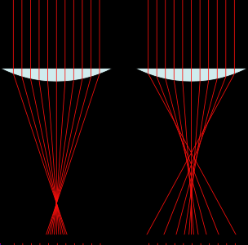
Arecibo Observatory
Instruments
  Line feed counters spherical aberration
Different parts of dish focus to different heights
430 MHz line feed (70 cm)

Slide 41
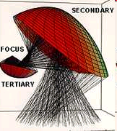
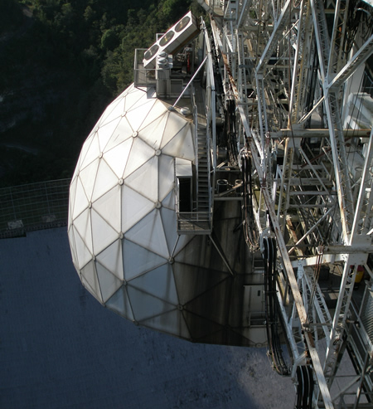
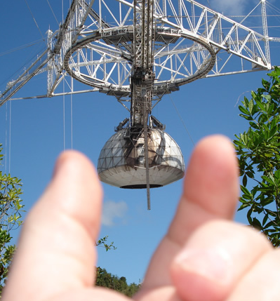
Arecibo Observatory
Instruments
  Gregorian dome houses instruments
    “gregorian” ⇒ secondary behind primary focus
Odd Puerto Rican berry!
Gregorian Dome

Slide 42


Inside the Gregorian Dome
Main dish
Tertiary reflector
Inside of dome is secondary reflector

Slide 43



ALFA
Made in Aust-ralia
Arecibo L-Band Feed Array
  Seven feeds in hexagonal array
ALFA receivers
ALFA apertures
… and SLU student

Slide 44

ALFA
Point Spread Function
  Multiple beams & asymmetries alias sources
  Combining beams into one image requires careful processing

Slide 45


L Band
1200 – 1800 MHz

Slide 46
ALFALFA
1335 - 1435 MHz
ALFALFA Observing band 1335 – 1435 MHz
Crowded!
ALFALFA Observing band 1335 – 1435 MHz
1420 MHz

Slide 47
ALFALFA
1335 - 1435 MHz
  100 MHz, 4096 channels
    ⇒ 24.4 kHz/channel
Recessional Velocities

Slide 48
ALFALFA
Distances
  Hubble Constant
    Currently 72 km/s/Mpc = 2.33 x 10¹⁸ s⁻¹
    Gives the age of the universe as 13.6 By
  Cosmological Distances (local)
  ALFALFA’s far view

Slide 49
Radio Sources
Continuum Sources
  Thermal radiation
  Synchrotron radiation
Spectral Line Sources
  Cool H!
  Some molecules

Slide 50
Continuum Radio Emission
Thermal emission minimal
mW/m²
Wein’s Law: for λ_{max} = 21 cm T = 13.8 mK
GHz
L Band
Planck Curve for 2.725K

Slide 51
Continuum Radio Emission
Continuum Radiation: Synchrotron
  e- spiral along magnetic fields
f_{radiation}
∝
Radiate due to acceleration (centripetal acceleration) “beamed” in forward direction (relativistic motion)‏
E_{electron}
Spectrum shows particle energy distribution (ie. Power Law)‏
L Band
Radiated Power
C Band
1.5
5
GHz

Slide 52





Continuum Radio Galaxies
Wide Angle Tailed Radio Galaxies
  C-shaped radio emissions
  shaped by “winds” due to smaller clusters of galaxies merging together …
  Even galaxies clusters are still evolving!
~ 500,000 ly

Slide 53


Continuum Radio Galaxies
Attached to cD galaxies
  cluster Dominant galaxies
    HUGE ellipticals in centers of galaxy clusters
      got big by eating neighbors
      some not done … multiple nuclei
~ 500 kly

Slide 54


Radio Galaxies
3C 75
  Dual radio galaxies
    two radio sources from same galaxy
      two nuclei

Slide 55


Radio Galaxies
3C 75
  Cluster in X-ray emission
    shows two nuclei, lumpy gas distribution

Slide 56
Spectral Radio Emission
21 cm
Spectral Line Radiation
  Hydrogen hyperfine structure
Spin-flip transition
  Emits radiation at 1.420405 GHz
  21.106 cm
  Spontaneous flip ~ 11 million years
  Collisional flip ~ 400 years

Slide 57
Cool HI in the Milky Way

Slide 58

Cool HI in the Milky Way
GALFA – Galactic ALFA
  Galactic HI in star-forming complexes
  Small-scale structure of Galactic HI
  Disk-Halo interferences
  Halo clouds and cloud-halo interactions
Surveys in the International Galactic Plane Survey

Slide 59
Extragalactic Cool HI
ALFALFA Science
  Expected to detect 25,000 objects
    Local low-mass HI dwarfs (≥ 10⁶ M)
    Gas-rich massive galaxies (≤ 10^{10.8} M)
  HI spectra provide
    Redshifts
    HI cloud masses
    HI disk populations & rotation rates
    History of tidal events
    Potential for future star formation
  Blind survey not prejudiced toward bright or interesting objects … offers surprises!

Slide 60

ALFALFA Data
Raw Data
  14 Spectra per second (7 feeds, 2 polarizations)
Time (RA)
ν
Frequency

Slide 61
ALFALFA Data
Raw Data
  14 Spectra per second (7 feeds, 2 polarizations)
Time (RA)
ν
Galactic HI (z = 0)
Increasing z

Slide 62
ALFALFA Data
Raw Data
  RFI: Radar
Time (RA)
ν
San Juan Airport Radar
Galactic HI (z = 0)
… and harmonics

Slide 63

ALFALFA Data
Raw Data
  RFI: Radar … and GPS bursts
Time (RA)
ν
San Juan Airport Radar
Galactic HI (z = 0)
… and harmonics

Slide 64
ALFALFA Data
Raw Data
  Galaxies: Known
Time (RA)
ν
San Juan Airport Radar
Galactic HI (z = 0)
AGC galaxies

Slide 65

ALFALFA Data
Raw Data
  Galaxies: Known and Unknown
Time (RA)
ν
San Juan Airport Radar
Galactic HI (z = 0)
New radio galaxy

Slide 66

ALFALFA Data
Cubes
  Spectra “griddded” into spatial images at increasing red shifts
Red shift
4096 channels!

Slide 67

The SLU cube
Arecibo Sky … 3 am in April
ALFALFA data cube at 11h 48m +13°

Slide 68




1148+13 Optical Images and Spectra
Double humped spectrum for edge-on
Single humped spectrum for face-on

Slide 69
1148+13
3-D plot of galaxies in the SLU cube
Bit of a clump …

Slide 70

1148+13
Distribution of Galaxies
  Hickson Compact Group
Hickson Compact Group 59

Slide 71


Other ALFALFA Results
Tidal Stream in Virgo Cluster
  500 kpc, ~ 7 x 10⁷ M (~10% of system mass)
    Seems to be remnant of a NGC 4532 and DDO 137 interaction
km/s, blue shifted with respect to the galaxies
G. Lyle Hoffman, et al, 1999 AJ 117 811-825
Koopmann, R.A., et al, 2008, ApJL 682, L85

Slide 72



Other ALFALFA Results
Virgo HI21 near Pinwheel galaxy (M99)
  Rotating HI cloud … First Dark Galaxy?
NGC 4254 showing extended spiral arm.
Minchin, R., et al, 2007, ApJ, in Press http://arxiv.org/abs/0706.1586
University of Alabama http://www.astr.ua.edu/Galleries.html

Slide 73

Other ALFALFA Results
Debunking the Dark Galaxy
  “An Act of Harassment”
    Part of a larger tidal stream from NGC 4254
Haynes, M. P., et al, 2007, ApJL 665, L19

Slide 74
The adventure continues ...

